Slide 1
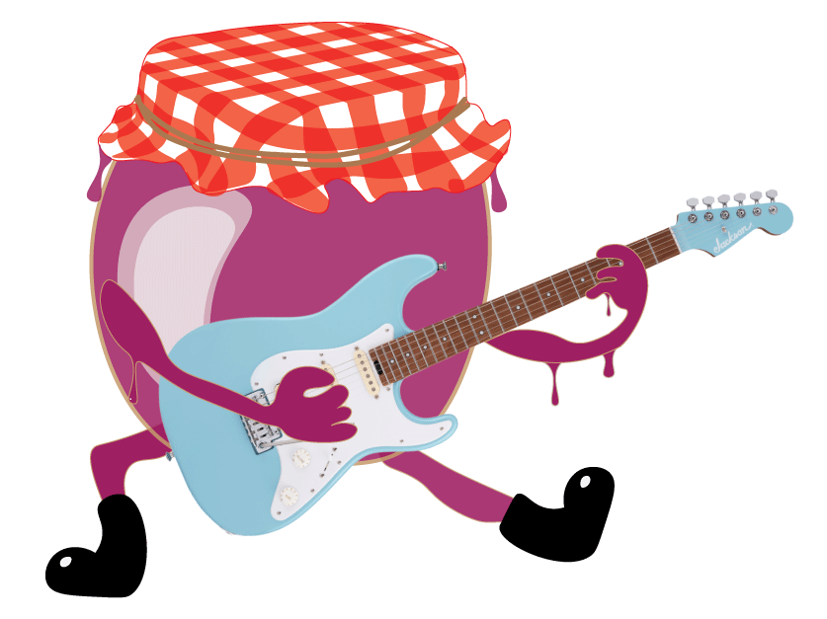
Jam Jelly
Music that Sticks!!!
Created by: Jenna, Ted, Sean and Shelby

Slide 2

Jam Jelly - Overview
Uses the Spotify API (https://developer.spotify.com/) to generate song recommendations based on a song or artist search query.
Users can broaden their music library by listening to related artists or songs with similar musicality.
Visual depictions of each query, via a radar chart, are given so users can better understand their own unique music preferences.
The Spotify API returns audio analysis for every recommended song.
Danceability
Valence
Temp
Liveness
Loudness
Instrumentalness

Slide 3
Jam Jelly - Tools and Tech
Project tracking/Version control: Slack, Git
Grade: A+
Languages/Frameworks: Python, Django
Grade: A
Hosting: Heroku
Grade: B-
Graphics: Adobe Illustrator
Grade: A+
Editors: VS Code, Sublime Text
Grade: A
Notes:
Database??? testing??

Slide 4
Jam Jelly - Challenges and Setbacks
Interfacing with Spotify API.
Obtaining client id and secret.
https://developer.spotify.com/dashboard/applications)
Parsing Spotify JSON responses to queries.
Deploying/Hosting to heroku.
Requirements.txt
Transferring backend information to website.
Settings.py
CSS/HTML quirks
SQLite3 Database
Make continuous improvements to Postgresql (a production grade database) (https://devcenter.heroku.com/articles/sqlite3)
Extend User Model to include two new fields:
Client ID
Client Secret

Slide 5
Questions?

